Slide 1

Network Design And Implementation Of Entire College Or University
Presented by Faculty
Riya Saproo (2020a1r060) Ms. Vishalika
Diya Gupta (2020a1r066) Assistant Professor
Stuti Berda (2020a1r044)
Arunima Magotra (2020a1r049)
Iftisam Tariq (2021a1l017)
DEPARTMENT OF COMPUTER SCIENCE AND ENGINEERING
MIET(Autonomous),JAMMU

Slide 2
Content
Introduction
Objectives
Network Requirements
Major Design Areas and Functional Areas
Existing Infrastructure
Network Devices
Request for Proposal (RFP)
IP addressing Plan
Routing Protocol Plan
Network Design
Summary

Slide 3
Introduction
This College Network Scenario is about designing a topology of a network that is a LAN (Local Area Network) for a College in which various computers of different departments are set up so that they can interact and communicate with each other by interchanging data. To design a networking scenario for a college which connect various departments to each other’s, it puts forward communication among different departments.

Slide 4
Objective
The main objective of the proposed network is to update the existing network and also enhance its capabilities and increase the flexibility of the network which will eventually provide good security.

Slide 5
Network Requirement
The new system should be able to reduce internet downtime. Download and upload links should be maintained above 5 Mbps speed requirement.
Network will be scalable.
The system should support remote access.
Should comprise of data centre with necessary security features and support

Slide 6
Major Design Areas And Functional Areas
The new system planned comprises of IP based switches that remain as the access point to LAN-based (ethernet) as well as Wi-Fi-based connectivity. These switches provide SNMP support as well so that traffic monitoring becomes easy.

Slide 7
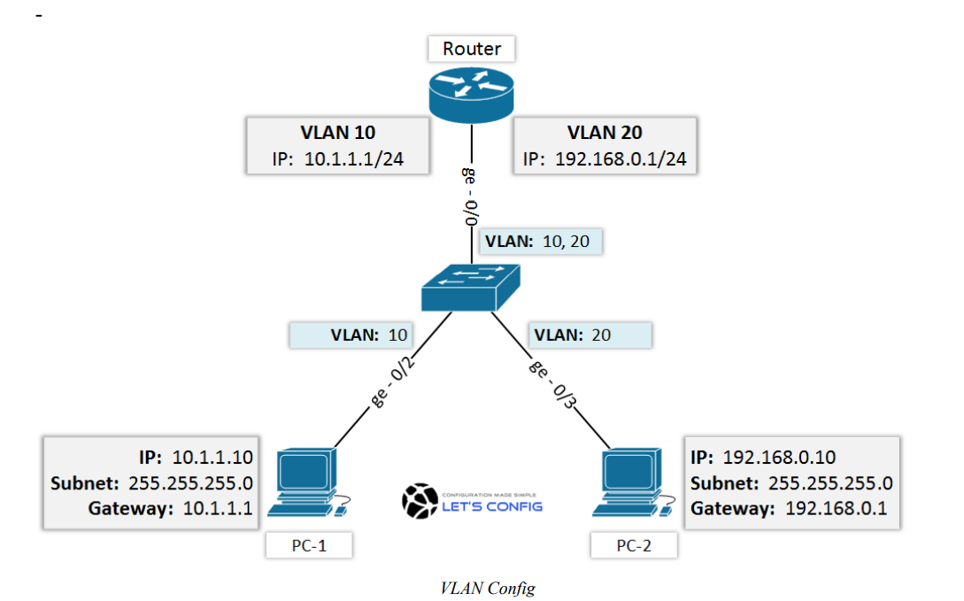

Slide 8
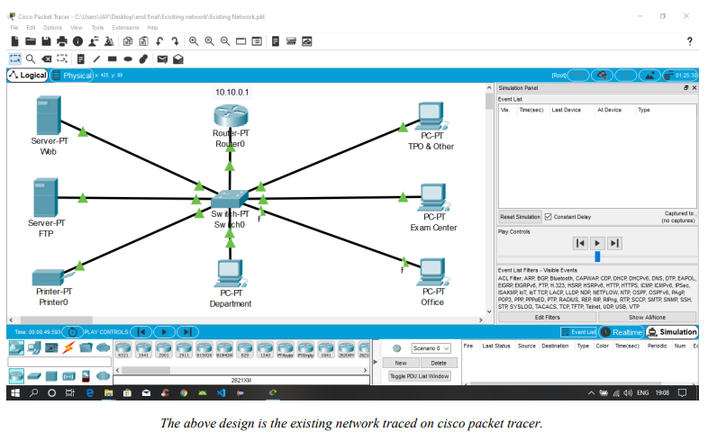
Existing Infrastructure

Slide 9
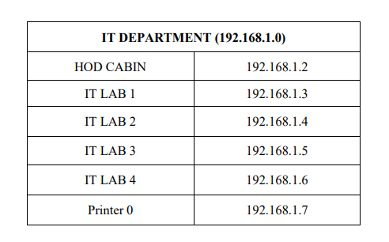
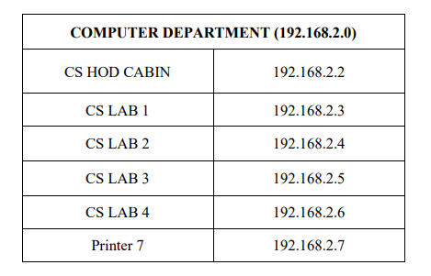
IP Addressing Plan

Slide 10
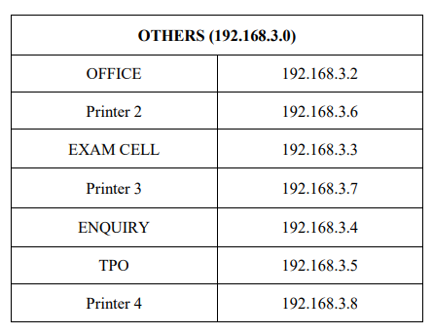
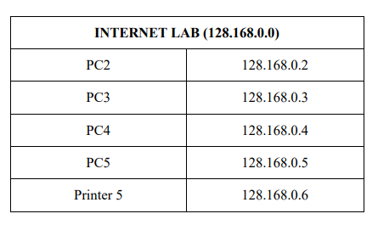
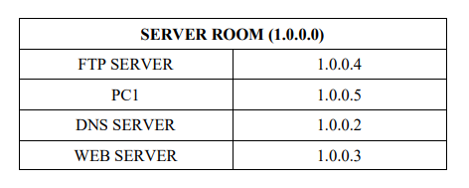
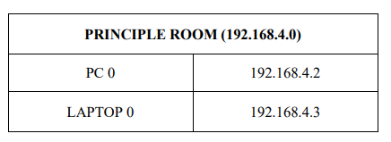

Slide 11
Routing Protocol Plan
Routing Information Protocol (RIP) is a dynamic routing protocol which uses hop count as a routing metric to find the best path between the source and the destination network. It is a distance vector routing protocol which has AD value 120 and works on the application layer of OSI model.
[AD – ADMINISTRATIVE DISTANCE value is a value that routers used in order to select the best path when there are two or more different routes to the same destination from two different routing protocols.]

Slide 12
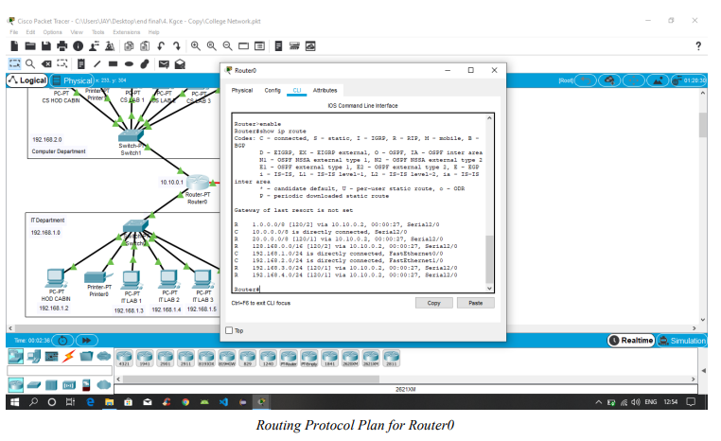

Slide 13
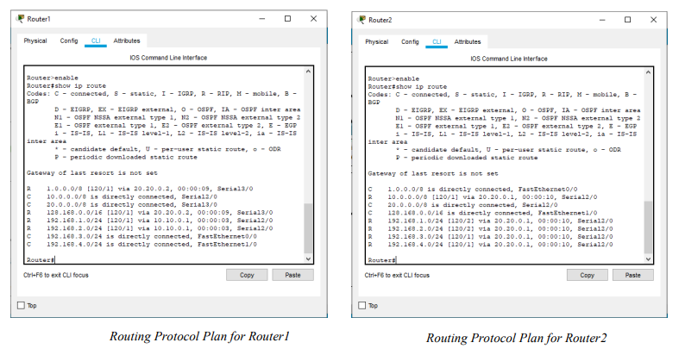

Slide 14
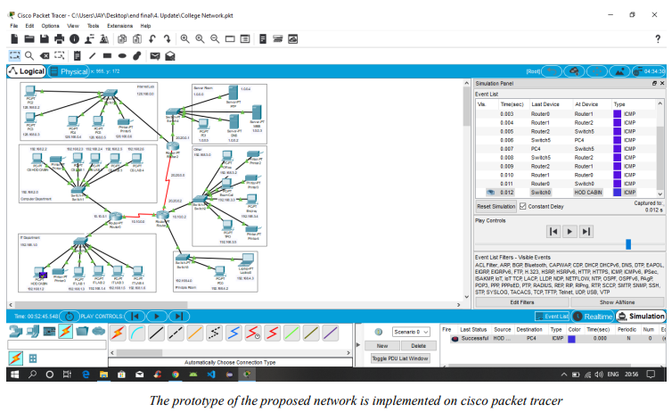

Slide 15
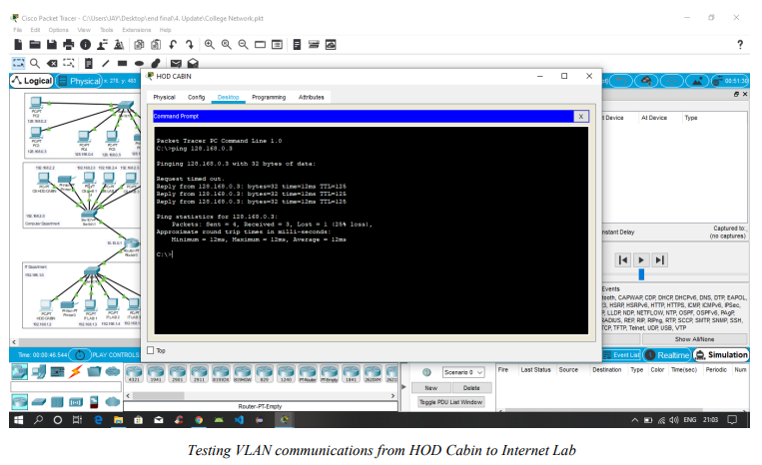

Slide 16
Summary
The outcome of the proposed system will be a fail-safe backbone network infrastructure which meets the requirements for readily available access to information and security of the private network, and also ensures optimized productivity when telecommunication services are accessed. The installed equipment allowed to organize high-speed wired and wireless Internet access throughout the whole complex of hospital buildings as well as providing transfer of all types of data throughout the single optimized network.

